Slide 1

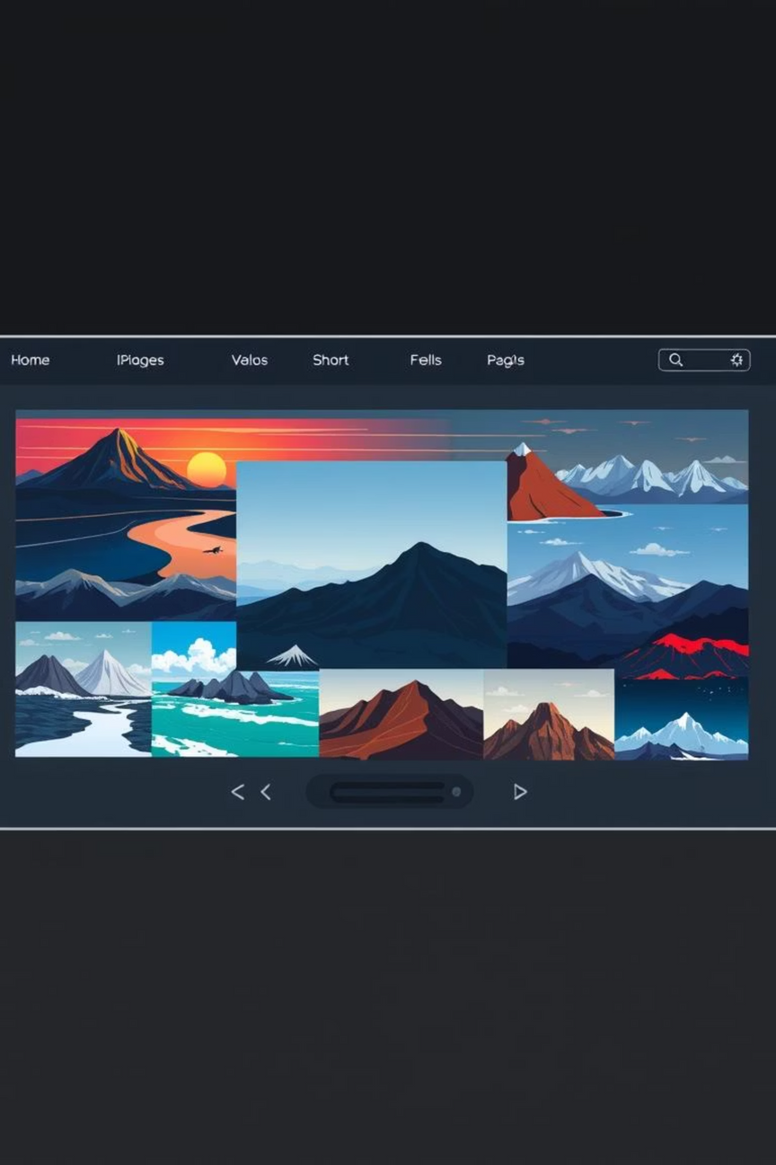
Image Slider Project Report
This report details the development and outcomes of the "Image Slider" project, an exercise in creating a dynamic and visually appealing image carousel using fundamental front-end technologies.
Notes:
1

Slide 2
Project Overview
Building an Interactive Image Carousel
The "Image Slider" project was designed as an intermediate-level web development task. Its primary objective was to construct an interactive user interface that allows seamless navigation through a series of images, emphasizing the integration of HTML, CSS, and JavaScript.
HTML for Structure
CSS for Styling
JavaScript for Functionality
Defining the foundational layout and elements.
Enhancing visual appeal and responsiveness.
Implementing interactive behaviors and logic.
Notes:
2

Slide 3

Core Project Requirements
The project had a clear set of requirements to ensure the final product was functional and met industry standards for user experience. Adherence to these guidelines was crucial for a successful implementation.
HTML Structure
CSS Styling
Organized container for images and navigation buttons (previous/next).
Visually appealing and responsive design with smooth transitions across devices.
JavaScript Logic
Image Array
Loading the first image, enabling button navigation, and ensuring a continuous loop.
A collection of at least five diverse images for the slider.
Notes:
3

Slide 4
Deep Dive into JavaScript Functionality
The JavaScript component was the heart of the image slider, dictating how users would interact with the images and how the carousel would behave.
Initial Image Load
Navigation Control
Seamless Looping
Upon page load, the JavaScript was responsible for dynamically displaying the first image from the array, setting the initial state of the slider.
Event listeners were implemented for "Next" and "Previous" buttons, updating the displayed image index and content based on user input.
The logic ensured that after reaching the last image, "Next" would transition back to the first, and "Previous" from the first would go to the last, creating an infinite loop.
Notes:
4

Slide 5

Enhancing User Experience
Beyond core functionality, a strong emphasis was placed on creating an intuitive and visually pleasing user experience. This involved thoughtful design choices and clear feedback mechanisms.
Smooth Animations
Subtle CSS transitions for image changes to provide a fluid, less abrupt viewing experience.
Intuitive Navigation
Clearly visible and clickable "Next" and "Previous" buttons with appropriate styling.
Current Position Feedback
Indicators (e.g., dots or numbers) to show which image is currently displayed out of the total.
Notes:
5

Slide 6



Automating the Slideshow
Bonus Challenge
As a bonus requirement, developers were tasked with implementing an automatic transition feature. This pushed for a deeper understanding of asynchronous JavaScript and timing events.
Set Interval
Pause on Hover
Resume on Leave
Using setInterval() to advance the slider every 3-5 seconds.
Implementing logic to pause the auto-play when the user hovers over the slider.
Automatically resuming the slideshow once the user's cursor leaves the slider area.
Notes:
6

Slide 7

Project Documentation and Submission
Comprehensive documentation and proper submission procedures were vital to demonstrate a professional approach to development and ensure project reproducibility.
Well-Commented Code: Every section of HTML, CSS, and JavaScript included clear comments explaining its purpose and functionality.
README Document: A detailed README.md file provided instructions on how to set up, run, and interact with the image slider.
Zip File Submission: All project files were consolidated into a single zip archive for organized delivery.
Notes:
7

Slide 8
Grading Criteria
Evaluating Quality and Functionality
40%
30%
Code Quality
UI Design
Cleanliness, efficiency, and adherence to best practices.
Visual appeal, responsiveness, and consistent styling.
20%
10%
Functionality
Bonus Task
Correct implementation of all core JavaScript features.
Successful implementation of the automatic slideshow.
Notes:
8

Slide 9




Key Takeaways from the Project
This project served as a foundational exercise, solidifying core front-end skills and demonstrating the power of integrating HTML, CSS, and JavaScript.
Integration Mastery
Responsive Design
Hands-on experience in combining all three core web technologies for a functional component.
Understanding the importance of adapting layouts for various screen sizes and devices.
User-Centric Focus
Asynchronous Logic
Prioritizing intuitive interactions and smooth visual feedback.
Practical application of JavaScript timing events for dynamic behaviors.
Notes:
9

Slide 10
Conclusion and Future Enhancements
The Image Slider project provided invaluable experience in creating a common web component, reinforcing best practices and problem-solving skills.
What I Achieved:
Successfully built a robust and interactive image slider meeting all core requirements.
Applied principles of responsive design for broad compatibility.
Enhanced user experience through smooth animations and clear navigation.
Implemented an automatic slideshow feature
Notes:
10

